Slide 1

Basic Details of the Team and Problem Statement
Ministry/Organization Name/Student Innovation: Ministry of AYUSH
PS Code: SIH1343
Problem Statement Title: Identification of Different Medicinal Plants/Raw materials through Image Processing Using Machine Learning Algorithms
Team Name: Terra
Team Leader Name: Yash Dwivedi
Institute Code (AISHE):
Institute Name: Galgotias University
Theme Name: MedTech, BioTech & Health-tech

Slide 2
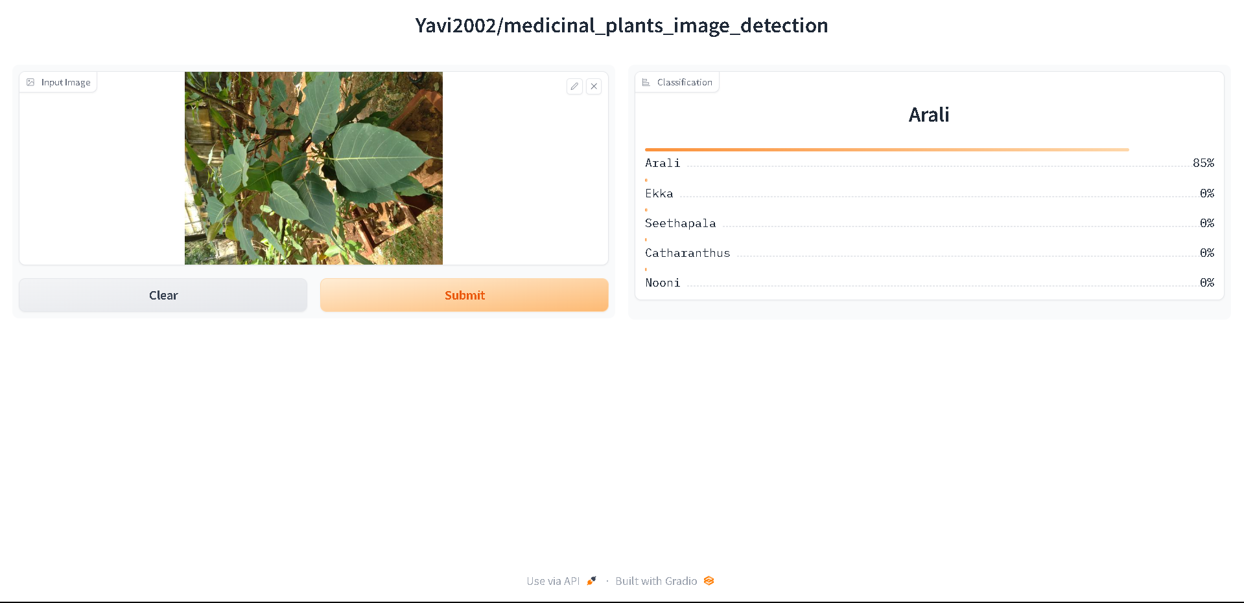
Idea/Approach Details
Describe your idea/Solution/Prototype here:
We propose a robust solution for the classification of medicinal herbs using a Vision Image Transformer (VIT) model.
This solution is designed to handle a substantial dataset of 9.7 GB, encompassing 84 distinct herb classes, and employs a Vision transformer with 85 million parameters.
The model has been trained over 50 epochs with a batch size of 8 to ensure accurate and comprehensive herb classification.
Additionally, it has a training accuracy of 98% and a test accuracy of 85%.
Describe your Technology stack here:
Vision Image transformer
Pytorch
Numpy, Pandas & Matplotlib
Gradio
Convolutional Neural Network

Slide 3
Idea/Approach Details
Use Cases:
Show stopper:
Indian Medical Herb Classifier
Herb Authentication
Herbal Medicine Quality Control
Herbal Product Development
Herbalist Assistance
Botanical Research
Telemedicine and Mobile Apps
Vision Image Transformer (VIT)
It is a supervised deep-learning way used for image classification. It works on self-attention.
It is designed to handle a substantial dataset of 9.7 GB, encompassing 84 distinct herb classes, and deploys with 85 million parameters.
The model has been trained over 50 epochs and it has a training accuracy of 98% and a test accuracy of 85%.
Gradio
Gradio simplifies ML model deployment with its intuitive API, supporting various frameworks and languages. It offers customization, real-time updates, and security features, making it easy to create interactive interfaces.
Gradio's scalability and active community support further enhance its value for developers.

Slide 4
Team Member Details
Team Leader Name : Yash Dwivedi
Branch (Btech/Mtech/PhD etc) : Btech Stream (ECE, CSE etc) : CSE Year (I,II,III,IV) : IV
Team Member 1 Name : Aman Kumar Mishra
Branch (Btech/Mtech/PhD etc) : Btech Stream (ECE, CSE etc) : CSE Year (I,II,III,IV) : IV
Team Member 2 Name : Daksh Arora
Branch (Btech/Mtech/PhD etc) : Btech Stream (ECE, CSE etc) : CSE Year (I,II,III,IV) : IV
Team Member 3 Name : Rashi Bhardwaj
Branch (Btech/Mtech/PhD etc) : Btech Stream (ECE, CSE etc) : CSE Year (I,II,III,IV) : IV
Team Member 4 Name: Shivangi Jadon
Branch (Btech/Mtech/PhD etc) : Btech Stream (ECE, CSE etc) : CSE Year (I,II,III,IV) : IV
Team Member 5 Name : Tarun Sarawgi
Branch (Btech/Mtech/PhD etc) : Btech Stream (ECE, CSE etc) : CSE Year (I,II,III,IV) : IV
Team Mentor Name : Mr. Abhishek Kumar Pandey
Category (Academic/Industry) : Academic Expertise (AI/ML/Blockchain etc) : Cloud Computing Domain Experience (in years): 17yrs

Slide 5
Important Pointers
Please ensure below pointers are met while
Kindly keep the maximum slides limit to 4 pages
All the topics should be utilized for description of your idea
Try to avoid paragraphs and post your idea in points
Keep your explanation precisely and easy to understand
Idea should be unique and novel. If it has a business potential more weightage will be given.
Apart from this PPT abstract of your idea will be asked separately while submitting
You need to save the file in PDF and upload the same on portal. No PPT, Word Doc or any other format will be supported
You can delete this slide (Important Pointers) when you upload the details of your idea on SIH portal.

